Slide 1
RNAfold and Subprocess
BioE 131/231
Fall 2018

Slide 2
Agenda for today
Launching external programs with subprocess
RNAfold: predicting nucleic acid secondary structure
Grab some sequences from Entrez, build a function to launch RNAfold, then fold your sequences
Done!

Slide 3
Using existing tools saves you time
Often, there is a program that someone’s written that will perform some complex analysis that you need to do. Rather than reinvent the wheel, it’s easier to simply run someone else’s program.
Recall that we used MUSCLE to generate a multiple alignment and FastTree to turn that into a phylogenetic tree in a previous lab. There, we dropped into a terminal and ran those commands manually. But what if we wanted to generate hundreds of alignments? It would take forever to do them manually.
Instead, we could have written a function to call MUSCLE from within Python, which will be demonstrated in the next few slides.

Slide 4
Python’s subprocess module
The subprocess module lets you launch a program from within Python and get the results back for further manipulation.
Import the module with:
import subprocess
In Python 3, the most common use-case has been consolidated into a single command:
proc = subprocess.run(args, input,
stdout=subprocess.PIPE, stderr=subprocess.PIPE,
check=True)
This will run the command given by ‘args’ passing ‘input’ on stdin and capturing the output from stderr and stdout. If the program fails (i.e., returns a non-zero exit code) an exception will be raised.

Slide 5
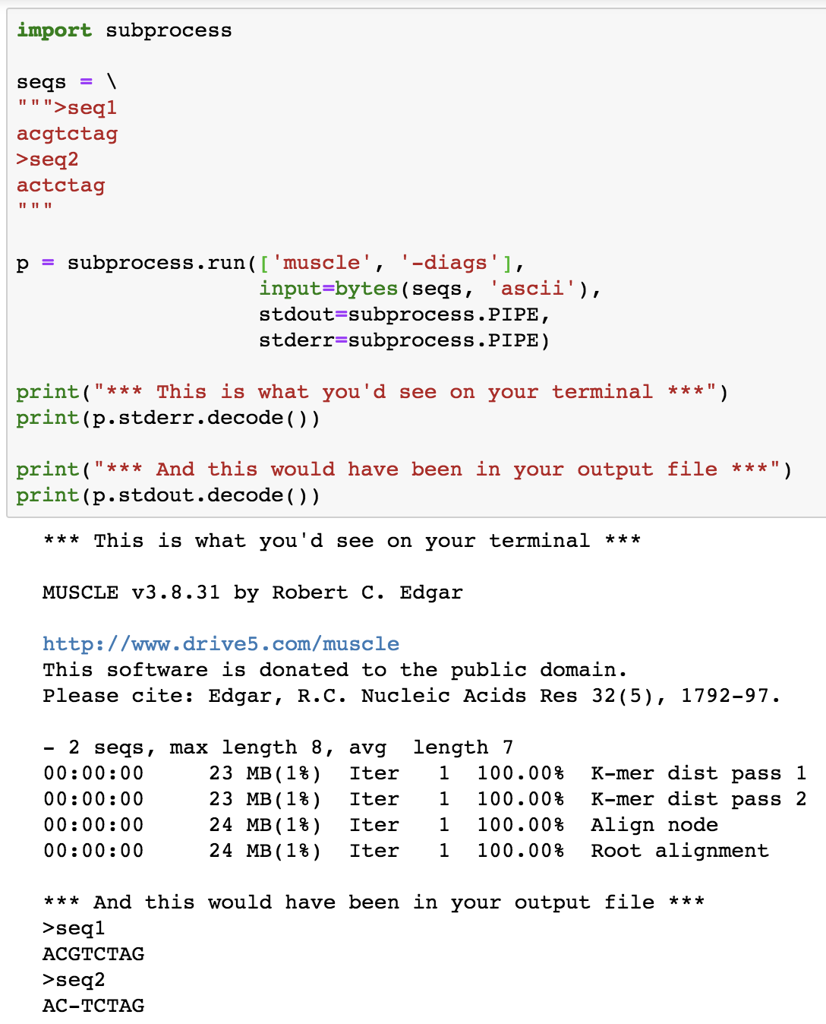
The command we want to run, and all its parameters, appear as the first positional argument. Break the command apart at the spaces and turn it into a list, e.g., ‘muscle -diags’ becomes [‘muscle’, ‘-diags’]
Our sample input FASTA file is encoded using bytes() and passed as input to muscle. We then tell subprocess to capture output from stdout and stderr by piping it back to us here in Python.
And finally we just print the two output data streams to the screen, making sure we .decode() the resulting bytes objects back into strings before we do.
If this were part of a pipeline, we could use Bio.SeqIO to parse the aligned FASTA from stdout and continue on.
Recall that…
On Linux terminals there are three “streams” of data: stdin – standard input, everything you type
stdout – output from programs you run
stderr – status messages and errors from programs you run

Slide 6
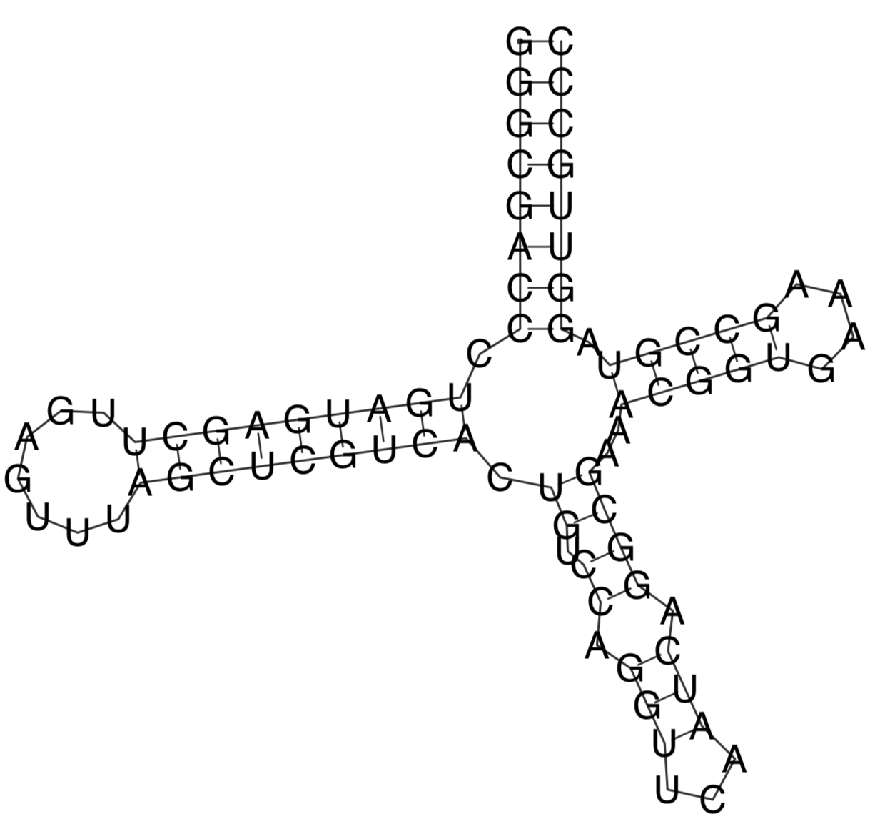
RNAfold predicts secondary structure
In class, you’ve learned that single-stranded RNA can fold to adopt interesting secondary structures which can allow them to perform different functions.
For today’s lab, you’ll need to familiarize yourself with the RNAfold command. This turns a nucleic acid sequence into a folded structure represented by paratheses and dots. The RNAplot command turns a folded structure in text format into a graphical representation.
NOTE: RNAfold produces a plot by default. Running RNAplot is superfluous in most cases.
GGGCGACCCUGAUGAGCUUGAGUUUAGCUCGUCACUGUCCAGGUUCAAUCAGGCGAAACGGUGAAAGCCGUAGGUUGCCC
RNAfold
RNAplot
((((((((.(((((((((.......))))))))).((.((.(((...))).))))..(((((....))))).))))))))

Slide 7
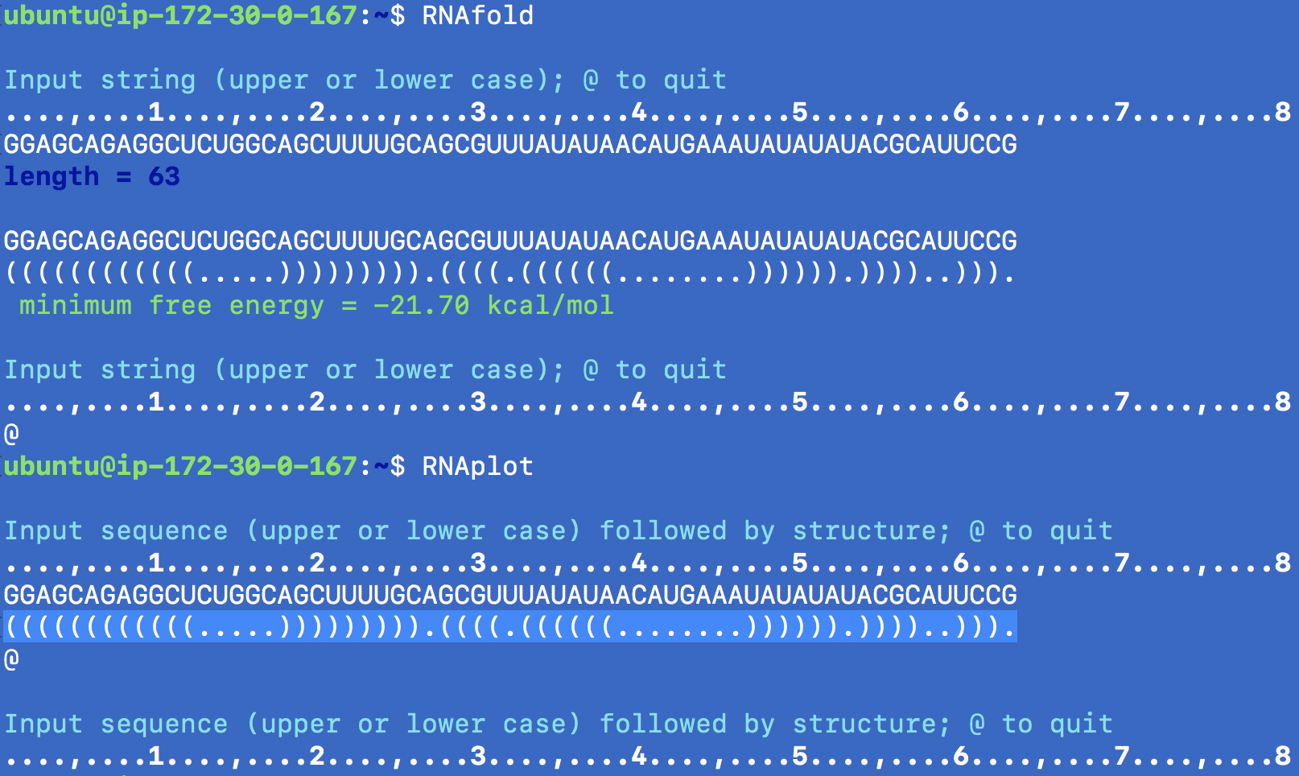
Running RNAfold/plot from the command line
Here’s the command we want to run using subprocess
This is our stdin, the nucleic acid sequence
This is the piece of stdout that we want to keep—the folded structure
Don’t forget to end your stdin with an @ symbol to tell RNAfold to quit.
RNAplot expects the nucleic acid sequence and folded structure as input, and produces the output as a file called “rna.ps” in your current directory. RNAfold does this too by default!

Slide 8
Ok, now get started…
Download the Lab 5 PDF from bCourses and go through it together with your lab partner
You will design a routine that runs RNAfold and RNAplot from within Python. It should take as input a nucleic acid sequence and produce a nice folded picture as output.
Using this routine, you will fold some sequences that you pull from a publication and compare your structures to those provided.

